Slide 1
WIND ENERGY
Wind is air set in motion by small amount of insolation reaching the upper atmosphere of earth.
It contains kinetic energy (K.E.) which can easily be converted to electrical energy. Nature generates about 1.67 × 10⁵ kWh of wind energy annually over land area of earth and 10 times this figure over the entire globe.
This wind energy, which is an indirect source of energy, can be used to run a wind mill which in turn drives a generator to produce electricity.
Although wind mills have been used for more than a dozen centuries for grinding grain and pumping water, interest in large scale power generation has developed over the past 50 years.
A largest wind generator built in the past was 800 kW unit operated in France from 1958-60.
The flexible 3 blades propeller was about 35 m in diameter and produced the rated power in a 60 km/hour wind with a rotation speed of 47 r.p.m

Slide 2
WIND CHARACTERISTICS
Wind speed increases roughly as 1/7th power of height. Typical tower heights are about 20–30 m.
Energy-pattern factor.
It is the ratio of the actual energy in varying wind to energy calculated from the cube of mean wind speed.
Or
It is the ratio of the actual energy output of a wind turbine over a given period to the theoretical maximum energy output that would be obtained if the wind blew steadily at the rated wind speed for the entire period.
This factor is always greater than unity which means the energy estimates based on mean (hourly) speed are pessimistic.
Characteristics of a good wind power site:
High annual wind speed.
An open plain or an open shore line.
A mountain gap.
The top of a smooth, well rounded hill with gentle slopes lying on a flat plain or located on an island in a lake or sea.
There should be no full obstructions within a radius of 3 km.

Slide 3
WIND ENERGY
Advantages:
It is a renewable energy source.
Wind power systems being non-polluting have no adverse effect on the environment.
Fuel provision and transport are not required in wind energy conversion systems.
Economically competitive.
Ideal choice for rural and remote areas and areas which lack other energy sources.
Disadvantages:
Owing to its irregularity, the wind energy needs storage.
Availability of energy is fluctuating in nature.
The overall weight of a wind power system is relatively high.
Wind energy conversion systems are noisy in operation.
Large areas are required for installation/operation of wind energy systems.
Present systems are neither maintenance free, nor practically reliable.
Low energy density.
Favorable winds are available only in a few geographical locations, away from cities, forests.

Slide 4
Principle of Wind Energy Conversion and Wind Power
The wind power can be computed by using concept of kinetics.
A wind mill works on the principle of ‘converting kinetic energy of the wind to mechanical energy’
U_{w} = Velocity of wind, km/h, and
ρ = Density of air (1.225 kg/m³ at sea level);
(Air density is a function of altitude, temperature and barometric pressure)
Air density A = Area, through which the air flows.
Then, the amount of air passing in unit time (m) through area A, with velocity U_{w} is
given by:
Mass, m = ρAU_{w}

Slide 5
Principle of Wind Energy Conversion and Wind Power
It is obvious that power output of a wind mill varies as cube of the wind velocity
i.e. Power output ∝ U_{w}³
Further, P_{total} can be expressed as
D = diameter (in meters) in horizontal axis aeroturbines.
where,
All this power cannot be extracted because, for this, wind velocity would have to be reduced to zero which means that the wind mill would accumulate static air around it which would prevent the wind mill operation.
Theoretically, a fraction16/27 = 0.593 (59.3%) of the power in the wind is ‘recoverable’.
This is called “Gilbert’s limit” or “Betz coefficient”.
Aerodynamically, efficiency for converting wind energy to mechanical energy can be reasonably assumed to be 70%.
So the mechanical energy available at the rotating shaft is limited to 40% or at the most 45% of wind energy.

Slide 6
Increase in wind speed with height above ground level is called wind shear
‘‘α” is known as power law index which depends on the roughness of terrain.
Its value is taken as 1/7 for open land and
0.10 for calm sea area.
The ideal wind energy have a low value of a α.
Normally, wind measurements are carried out an elevation of 10 m.
However, modern wind turbines are installed at a winds height of 25 to 50 m.

Slide 7
The combined effects of variations of wind speed and diameter.

Slide 8
EXTRACTION OF WIND ENERGY
Energy from wind stream is extracted by a wind turbine, by converting the kinetic energy (K.E.) of the wind to rotational motion required to operate an electric generate.
In order to compute the mathematical relationships, let us make the following assumptions:
The flow of wind is ‘incompressible’, and hence the air stream diverges as it passes through the turbines.
The mass flow rate of wind is ‘constant’ at far upstream, at the rotor and at far down stream.

Slide 9
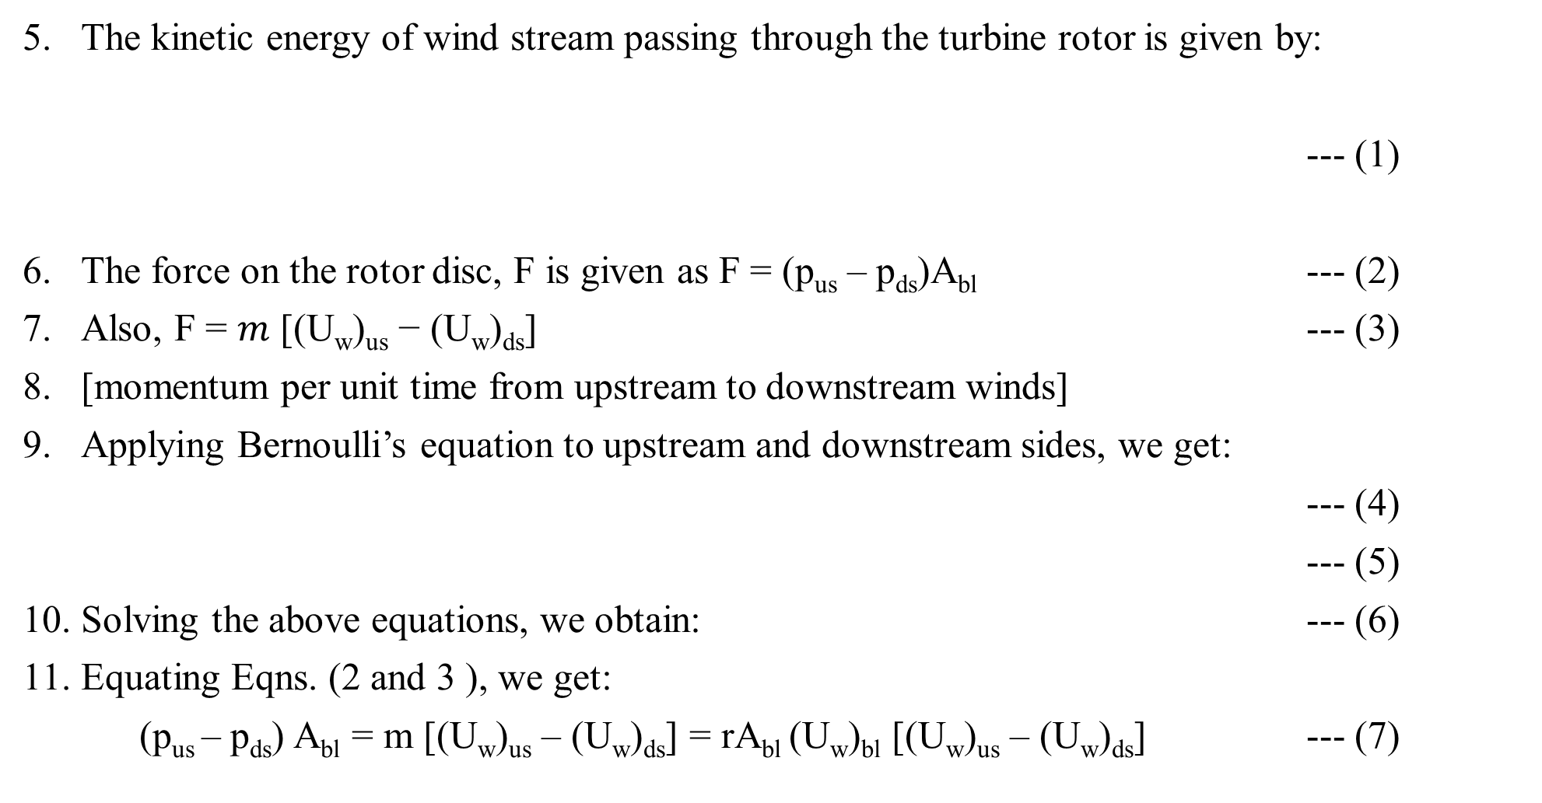
Cont.…
The kinetic energy of wind stream passing through the turbine rotor is given by:
--- (1)
The force on the rotor disc, F is given as F = (p_{us} – p_{ds})A_{bl} --- (2)
Also, F = $m$ [(U_{w})_{us} − (U_{w})_{ds}] --- (3)
[momentum per unit time from upstream to downstream winds]
Applying Bernoulli’s equation to upstream and downstream sides, we get:
--- (4)
--- (5)
Solving the above equations, we obtain: --- (6)
Equating Eqns. (2 and 3 ), we get:
(p_{us} – p_{ds}) A_{bl} = m [(U_{w})_{us} – (U_{w})_{ds}] = rA_{bl} (U_{w})_{bl} [(U_{w})_{us} – (U_{w})_{ds}] --- (7)

Slide 10
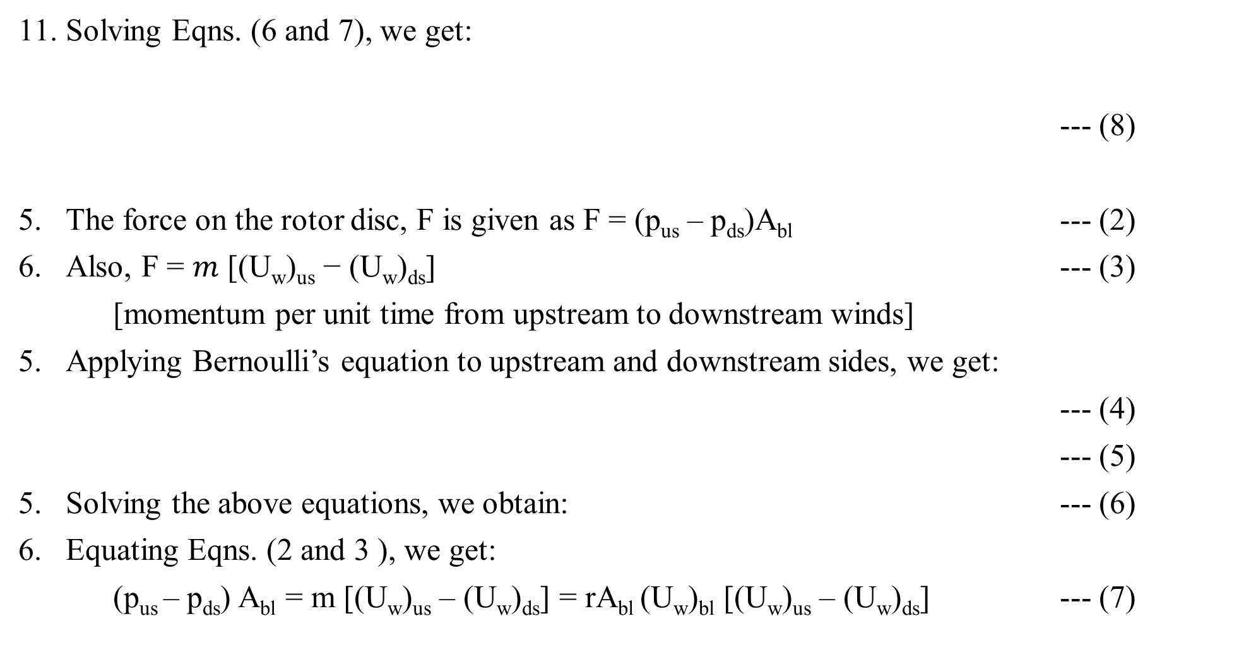
Cont.…
Solving Eqns. (6 and 7), we get:
--- (8)
The force on the rotor disc, F is given as F = (p_{us} – p_{ds})A_{bl} --- (2)
Also, F = $m$ [(U_{w})_{us} − (U_{w})_{ds}] --- (3)
[momentum per unit time from upstream to downstream winds]
Applying Bernoulli’s equation to upstream and downstream sides, we get:
--- (4)
--- (5)
Solving the above equations, we obtain: --- (6)
Equating Eqns. (2 and 3 ), we get:
(p_{us} – p_{ds}) A_{bl} = m [(U_{w})_{us} – (U_{w})_{ds}] = rA_{bl} (U_{w})_{bl} [(U_{w})_{us} – (U_{w})_{ds}] --- (7)

Slide 11
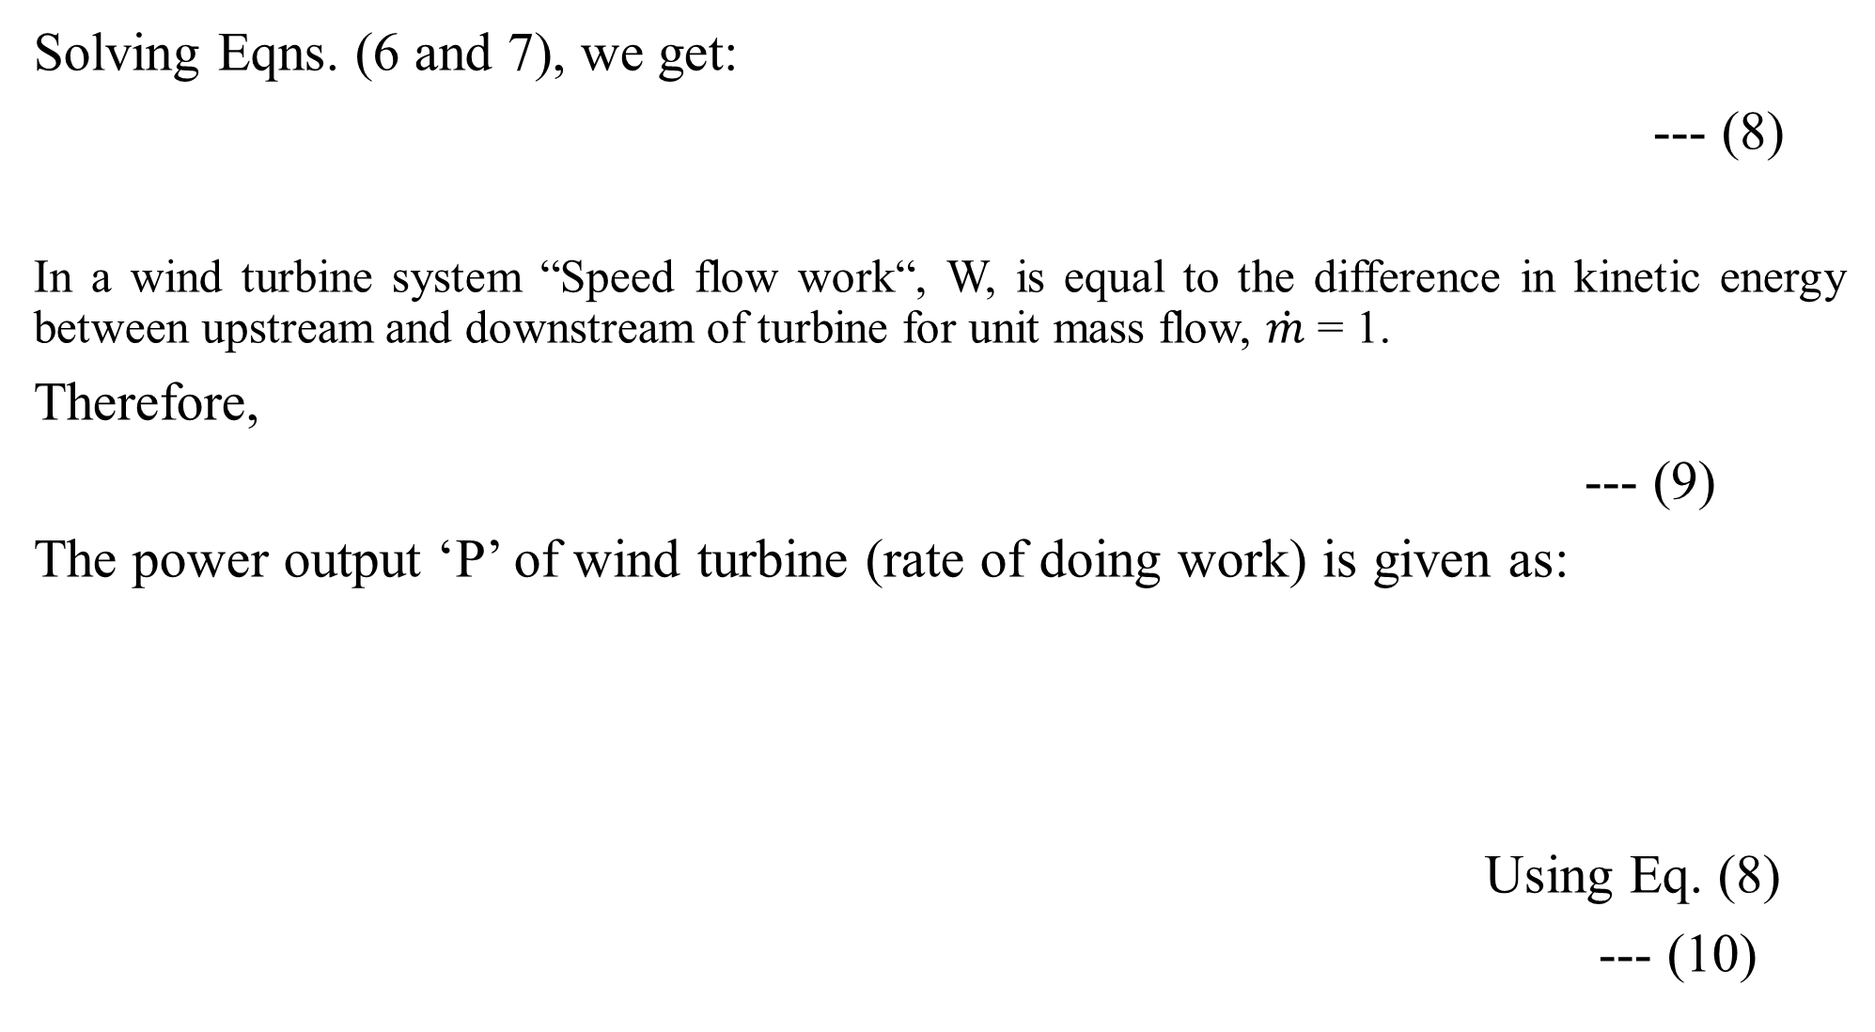
Solving Eqns. (6 and 7), we get:
--- (8)
In a wind turbine system “Speed flow work“, W, is equal to the difference in kinetic energy between upstream and downstream of turbine for unit mass flow, $\dot{m}$ = 1.
Therefore,
--- (9)
The power output ‘P’ of wind turbine (rate of doing work) is given as:
Using Eq. (8)
--- (10)

Slide 12
To get P_{max} (maximum turbine output), differentiating Eqn. (10) w.r.t. (U_{w})_{ds} and
equating to zero, we get:
The above quadratic equation has the following two solutions.
For power generation (U_{w})_{ds} < (U_{w})_{us}, so we can have only ---(10_{a})
Substituting Eqn. (10a) in Eqn. (10), we get:
--- (11)
-
Total power in the wind, stream -- (11_{a})
--- (12)

Slide 13
Performance of Wind Mills
The performance of a wind mill is defined as ‘Co-efficient of performance‘(C_{p})
...(13)
Where, ρ = Density of air, A = Swept area, and U_{w} = Velocity of wind.
Tip speed ratio (TSR) = U_{bt}/U_{w}
where, U_{bt} = Speed of blade tip.
It can be seen that C_{p} is the lowest of Savonius and Dutch types
The propeller types have the highest value.
In the designing of wind mills, it is upper most to keep the power to weight ratio at the lowest possible level.
The maximum theoretical coefficient of performance (C_{p}) is 0.593.

Slide 14
VARIATION OF POWER OUTPUT WITH WIND SPEED
The actual power output of a wind turbine generator (WTG) system depends on the following wind speeds:
Actual wind speed,
Rated wind speed,
Cut-in speed
i.e. speed at which system losses ‘equal’ the extracted wind power
Cut-out speed
i.e., speed at which the wind mill has to be ‘shut down’ for safety reasons

Slide 15
The power can be approximated by the relation:
...(14)

Slide 16
ANALYSIS OF AERODYNAMIC FORCES ON A BLADE
The given figure shows the vector diagram of forces on an elemental blade section of an aero-turbine, the blade rotating to the left.
The blade is a typical cross-sectional element of a two-bladed aero-turbine.
The element shown is at some radius ‘r‘ from the axis of rotation, and is moving to the left.
U_{w} = Wind velocity that inpinges on the blade,
(U_{w})_{T} = Wind velocity in plane of rotation due to blade turning,
(U_{w})_{R} = Resultant wind velocity seen by Aero- turbine blade
F_{L} = Lift force [Normal to (U_{w})_{R}],
F_{D} = Drag force [Parallel to (U_{w})_{R}],
F_{R} = Resultant force on the blade,
F_{T} = Torque producing component of F_{R} making aero-turbine rotate,
F_{th} = Thrust force component of F_{R},
α = Angle of attack of the blade, and
β = Blade pitch angle.

Slide 17
— (U_{w})_{T} when added vectorially to U_{w} gives (U_{w})_{R}, seen by the rotating blade element.
— F_{L} caused by the acro-dynamic shape of the blade is perpendicular to (U_{w})_{R}. F_{D} is parallel to (U_{w})_{R}.
— The vector sum of F_{L} and F_{D} is F_{R} which has a torque producing component F_{T} and and a thrust producing component F_{th}. The component F_{T} drives the aeroturbine rotationally, while the component F_{th} tends to flex the blade and also overturn the aero-generator.
— The angle of attack ‘α‘ of the acro-dynamic element determines lift and drag forces and hence speed and torque output of the aero-turbine.
These quantities can be altered by changing the blade pitch angle ‘β‘, and this is the basic torque control method used on large variable pitch ‘wind-electric generators’.

Slide 18
DESIGN OF WIND TURBINE ROTOR
In a propeller type wind turbine, the following two forces operate on the blades:
Axial thrust:
It acts in the same direction as that of the flowing wind stream.
Circumferential force:
It acts in the direction of wheel rotation that provides the torque.
Thrust on Turbine Rotor:
A turbine extracts wind energy, causing the difference in momentum of air streams between the upstream and downstream sides as shown in figure.
(U_{w})_{us} = Wind velocity-upstream;
(U_{w})_{ds} = Wind velocity-downstream;
D = Dia. of turbine.

Slide 19
---- (8)
--- (15)
--- (11_{a})
- - - (16)
Equation 16 indicates that for designing a wind energy generator (WEG) a large axial force can be obtained by using large diameter turbines.
The upper limit of the diameter needs to be optimized by matching structural design with economy.

Slide 20
WIND ENERGY PATTERN FACTOR (EPF):
This is the ratio of power from speed distribution to the power from coverage speed of the turbine blades.
Generally, EPF lies between 2 to 5.
BASIC COMPONENTS OF WIND ENERGY CONVERSION SYSTEM (WECS) :
Wind turbines (Aeroturbines):
This convert the energy of moving air into rotary mechanical energy. These turbines requires pitch and yaw controls for proper operation.
2. A mechanical interface consisting of a step up gear and a suitable coupling transmits the rotary mechanical to an electrical generator.
The output of this generator is connected to the road or power grid as the application demands.
3. A controller serves purposes of sensing:
Wind speed,
Wind direction,
shafts speed and torques at one or more points,
Output power and generator temperature as necessary,
Appropriate control signals for matching the electrical output to the wind energy input, and
Protect the system from extreme conditions brought about by strong winds, electrical faults etc.

Slide 21
CONSIDERATIONS FOR SELECTION OF SITE FOR WIND ENERGY CONVERSION SYSTEMS (WECS)
Availability of anemometry data.
High annual average wind speed.
Availability of wind curve at the proposed site.
Wind structure at the proposed site.
Altitude of the proposed site.
Terrain and its aerodynamic.
Local ecology.
Distance to roads or railways.
Nearness of site to local centre/users.
Favorable land cost.
Nature of ground.

Slide 22
Aero foil Nomenclature
Aerodynamics: It is the branch of science which deals with air and gases in motion and their mechanical effects.
Airfoil or aerofoil: A streamlined air surface designed for air to flow around it in order to produce low drag and high lift forces.
Angle of attack: It is the angle between the relative air flow and the closed of the air foil
Blade. An important part of a wind turbine that extracts wind energy.
Leading edge: It is the front edge of the blade that faces towards the direction of flow.
Trailing edge: It is the rear edge of the blade that faces away from the direction of wind flow.
Mean line. A line that is equidistant from the upper and lower surfaces of the air foil
Camber: It is the maximum distance between the mean line and the chord line, which measures the curvature of the airfoil.
Rotor: It is the primary part of the wind turbine that extracts energy from the wind.
It constitutes the blade-and-hub assembly.
Hubs: Blades are fixed to a hubs which is a central solid part of the turbine.
Pitch angle: It is the angle between the direction of wind and the direction perpendicular to the planes of blades.

Slide 23
Pitch control: It is the control of pitch angle by turning the blades or blade tips.
Yaw control: It is the control for orienting (steering) the axis of wind turbine in the direction of wind.
Teethering:
It is see-saw like swinging motion with hesitation between two alternatives.
The plane of wind turbine wheel is swung in inclined position at higher wind speeds by teethering control.
Solidity: It is ratio of blade area to the swept area
i.e. area covered by the rotating rotor
Drag force.
It is the force component which is in line with the velocity of wind.
Lift force.
It is the force component perpendicular to drag force.

Slide 24
Wind speeds for turbines:
Cut-in-speed:
It is the wind speed at which wind–turbine starts delivering shaft power.
For a typical horizontal shaft propeller turbine it may be around 7 m/s.
Mean wind speed:
Rated wind speed:
It is the velocity at which the wind–turbine generator delivers rated power.
Cut-out wind velocity (furling wind velocity):
It is the speed at which power conversion is cut out.
Lift force: The component of force at right angles to the direction of air stream on the airfoil is called the lift force.
Drag force:
The component of force in the direction of stream is called drag force (FD).

Slide 25
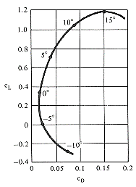
The lift coefficient is defined as: C_{L} = F_{L}/qS ,
where F_{L} is the lift force,
S the area of the wing and
q = (rU²/2) is the dynamic pressure with
r the air density and
U the airspeed.
Similarly, the drag coefficient is written as:
CD = F_{D}/qS ,
where F_{D} is the drag force and the other symbols have the same meaning.
The numerator and denominator of these two equations have the dimension of force and so the equation is dimensionless.

Slide 26
LIFT AND DRAG–THE BASIS FOR WIND ENERGY CONVERSION
When air stream approaches the airfoil along the axis of symmetry, the force acting on the body is only the drag force, in the direction of flow and there is no lift force.
The production of lift force requires asymmetry of flow while drag force exists always.
It is possible to create drag without lift but impossible to create lift without drag.
‘Lift forces’ are produced by changing the velocity of air stream flowing over either side of the lifting surface–speeding up the air flow causes the pressure to drop, while slowing the air stream down leads to increase in pressure.
In other words, any change in velocity generates a pressure difference across the lifting surface.
The pressure difference produces a force that begins to act on the high pressure side and moves towards the low pressure side of the lifting surface which is called an airfoil.
A good airfoil has high lift/drag ratio (LDR); in some cases it can generate lift forces perpendicular to air stream direction, 30 times as great as the drag force parallel to the flow.
The lift increases as the angle formed at the junction of the airfoil and the air stream (the angle of attack) becomes less and less acute, up to the point where the angle of the air flow on low pressure side becomes excessive.
When this happens, the air flow breaks away from the low pressure side, a lot of the turbulence ensues, the lift decreases and the drag increases quite substantially; this phenomenon is known as stalling.

Slide 27
Comparison between Horizontal axis and Vertical axis Wind Machines

